Slide 1
Session 05 Addressing
Subject : Z1451 / Jaringan Komputer Year : 2015

Slide 2
References
Main Reference Session 06: Forouzan, B.A., (2010). TCP/IP Protocol Suite, 4th Edition, Mc.Graw-Hill Chapter 2.4, 5 Forouzan, B.A., (2010). Data Communications and Networking, 4th Edition, Mc.Graw-Hill Chapter 19

Slide 3
Learning Outcomes
The students will be able to explain and use addressing scheme.

Slide 4
Outline
Physical Address
Logical Addess
Application Access
DHCP

Slide 5
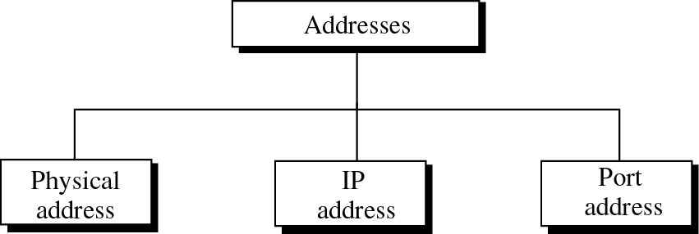
Addresses in TCP/IP

Slide 6
Physical Address
MAC Addresses are split in two:
1st Half is the OUI
2nd Half is Vendor Assigned
Format: oktet
44-AB-5F-DF-C1-FB

Slide 7
Logical Address - IP Address
IP Address
A logical address used in TCP/IP networking for identifying a host in the network
IP Address Characteristics
An IP address is 32 bits in size, unique, grouped into four 8-bit octets
Octets are separated by decimal points
Network Administrator
IP addresses are assigned by a network administrator according to an organization’s valid IP address range.
ICANN (Internet Corporation for Assigned Names & Numbers)
Central authority on Internet addresses and names.
A group of IP addresses must be obtained via an ISP.

Slide 8
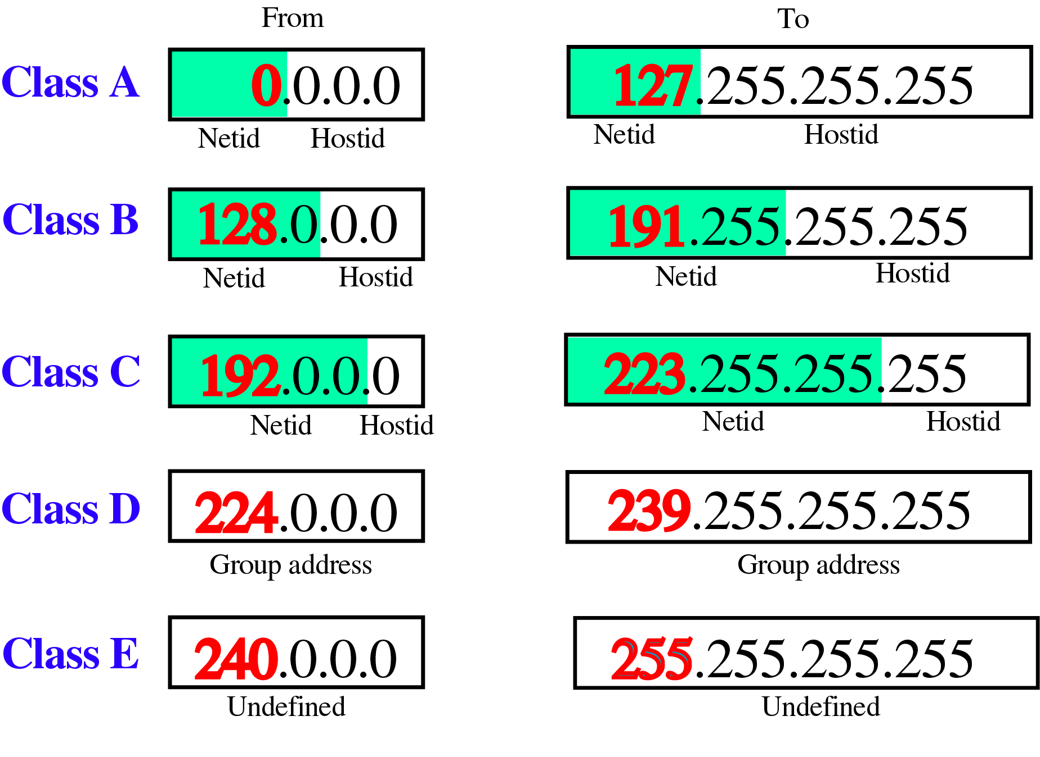
Classful Addresses

Slide 9
Special IP Addresses
Some IP address numbers are reserved for special functions.
IP address whose numeric value is the highest value in the network (host bits all equal to one) is a broadcast address.
IP addresses with first octet of 127 such as 127.0.0.1 is a loopback IP used to test local workstation communication
IP addresses ending in “1” are typically reserved for gateway.

Slide 10
Private Addresses
A number of blocks in each class are assigned for private use. They are not recognized globally
Several techniques exist to hide internal network IP addresses from outside view
Any organization can use these addresses provide they adhere to the rules
All connectivity to an Internet host must be provided by a Network Address Translator

Slide 11
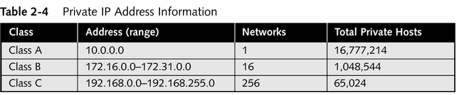
Private IP Addresses
Reserved IANA IP addresses for Private Internets
10.0.0.0 - 10.255.255.255
A single Class A network
172.16.0.0 - 172.31.255.255
Sixteen continuous Class B Networks
192.168.0.0 - 192.168.255.255
256 contiguous Class C networks

Slide 12
Subnetting
Subnetting
Allows the use one class of addresses for several network segments
A subnetted address is comprised of three parts
Network address
Subnet address
Host address
Subnet address uses part of the host address for subnet address assignment
Efficient use of IP addresses

Slide 13
Subnetting
A subnet mask is a special bit pattern that blocks off the network portion of an IP address with an all-ones pattern
This activity of stealing bits from the host portion of further subdivide the network portion of an address is called subnetting a network address, or subnetting.
A subnet mask that is larger than the default mask for the address in use divides a single network IP address into multiple subnetworks

Slide 14
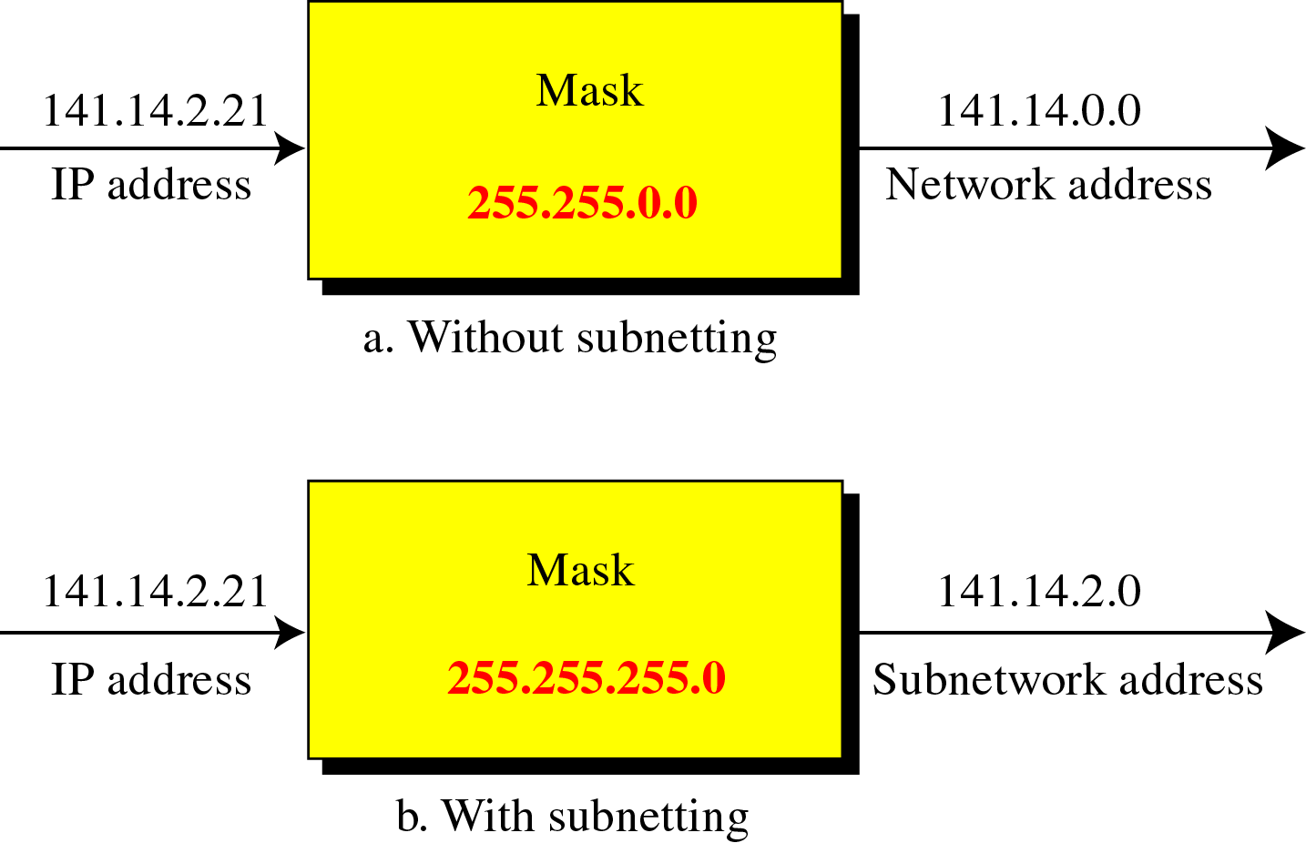
Default mask and subnet mask

Slide 15
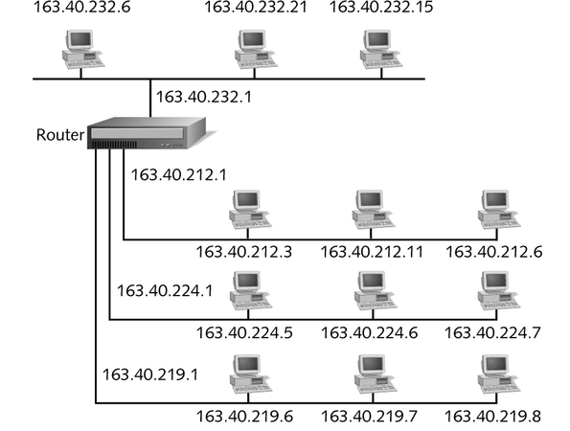
Subnetting
First 2 octets represent part of extended network prefix.
3rd octet represents subnet.
4th octet represents host/machine/device.
Router needed to interpret addresses.
IP ending in “1” always reserved for gateways address.

Slide 16
Application Addressing
Target user specified by User identification called socket in TCP/IP
Transport entity identification
Generally only one per host
If more than one, then usually one of each type
Specify transport protocol (TCP, UDP)
Host address
An attached network device
In an internet, a global internet address

Slide 17
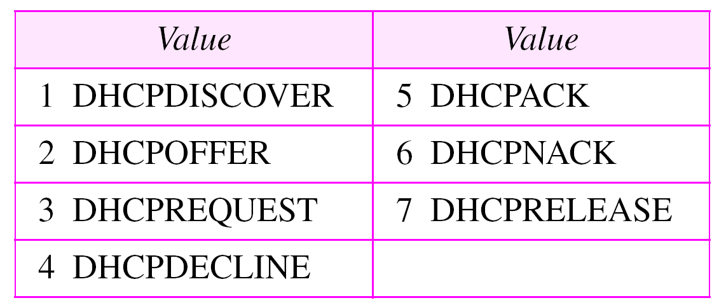
DHCP
Table 16.2 Options for DHCP

Slide 18
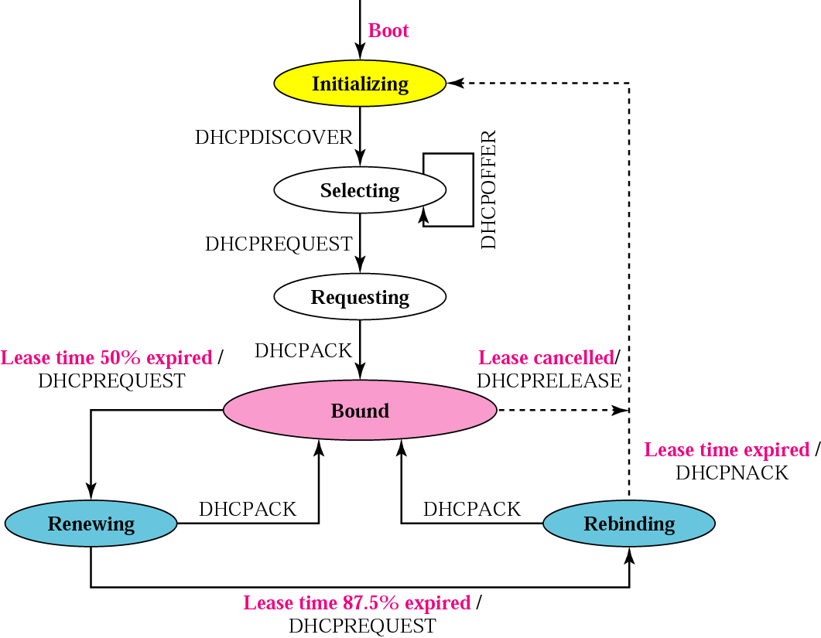
DHCP

